Slide 1
Getting Started with Python for Data Analytics
All Teach, All Learn
April 15, 2026
Adam Kortis

Slide 2
Presentation Goals
Understanding Python and its role in data analytics.
Setting up Python, software, and tools on your computer.
Implementing Python into your workflow for analytics using modules, scripts, Excel, and Power BI.

Slide 3
Personal Background
Started at the Anderson Center in Feb 2023
Primary focus is Learning Health Networks
Using Python as primary analytics tool for 7 to 8 years
Originally used some combination of SAS or R
No CS degree (Math, Economics)
Self-taught in Python and ran into some roadblocks

Slide 4
Understanding Python and its Role in Data Analytics
Python is not a data analytics language
It is a general-purpose language with modules built for data analysis, data science, data display, and data querying.
Modules provide the extensions to the language.
Pandas
Numpy
Matplotlib
Scikit Learn
Tensor Flow
Database modules
Combining modules with the features of the language: loops, conditionals, classes, functions, etc. create the real power and strength of language.
Can now be integrated in Excel and Power BI.
https://github.com/AdamKortis/cchmc_python_getting_started

Slide 5
Understanding Pros and Cons of Python
Pros
Cons
Free Open Source
Easy to write and read (syntax)
Modules that extend the base language
General use of standard programming paradigms: loops, conditions, classes, functions
Development software/tools
Development Speed
Flexibility/Resuability
Not designed for data analytics
Learning the language (coding/CS)
Learning the modules
Development software/tools
Run Speed
No Default Setup
Accounting for versions

Slide 6
What do you need to get started?
Download and install Python
Set up Python and PIP in your environment Path Variables
Choose an editor
Download, install, and setup the editor
Install relevant modules
Begin to code

Slide 7
Setting Up and Installing Python
https://www.python.org/downloads/
Download Python install manager – may need temporary admin rights
May need to take note of install directory
When installing make sure to add Python to path if not you will have to manually add it.
Checking or adding Python and PIP to environment variables
Python
C:\Users\<User Name>\AppData\Local\Programs\Python\<version>
PIP
C:\Users\<User Name>\AppData\Local\Programs\Python\<version>\Scripts
Open Control Panel >> User Accounts >> User Accounts >> Change my environment variables
Select Path variable and click Edit
Click new and add each directory listed above.
Click Ok then Ok

Slide 8
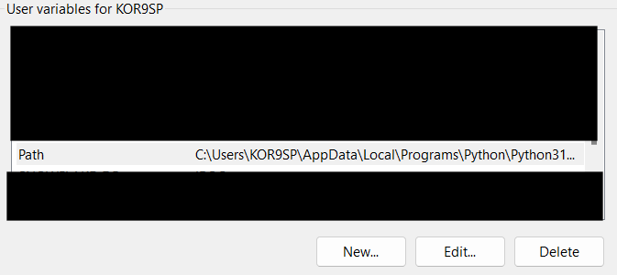
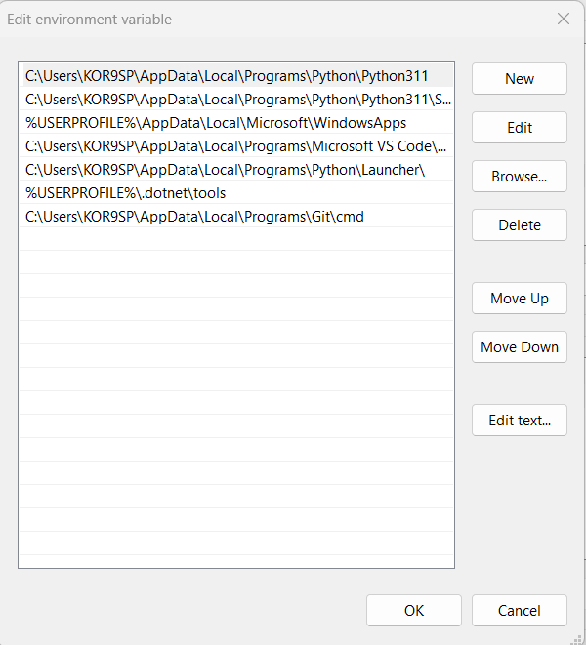

Slide 9
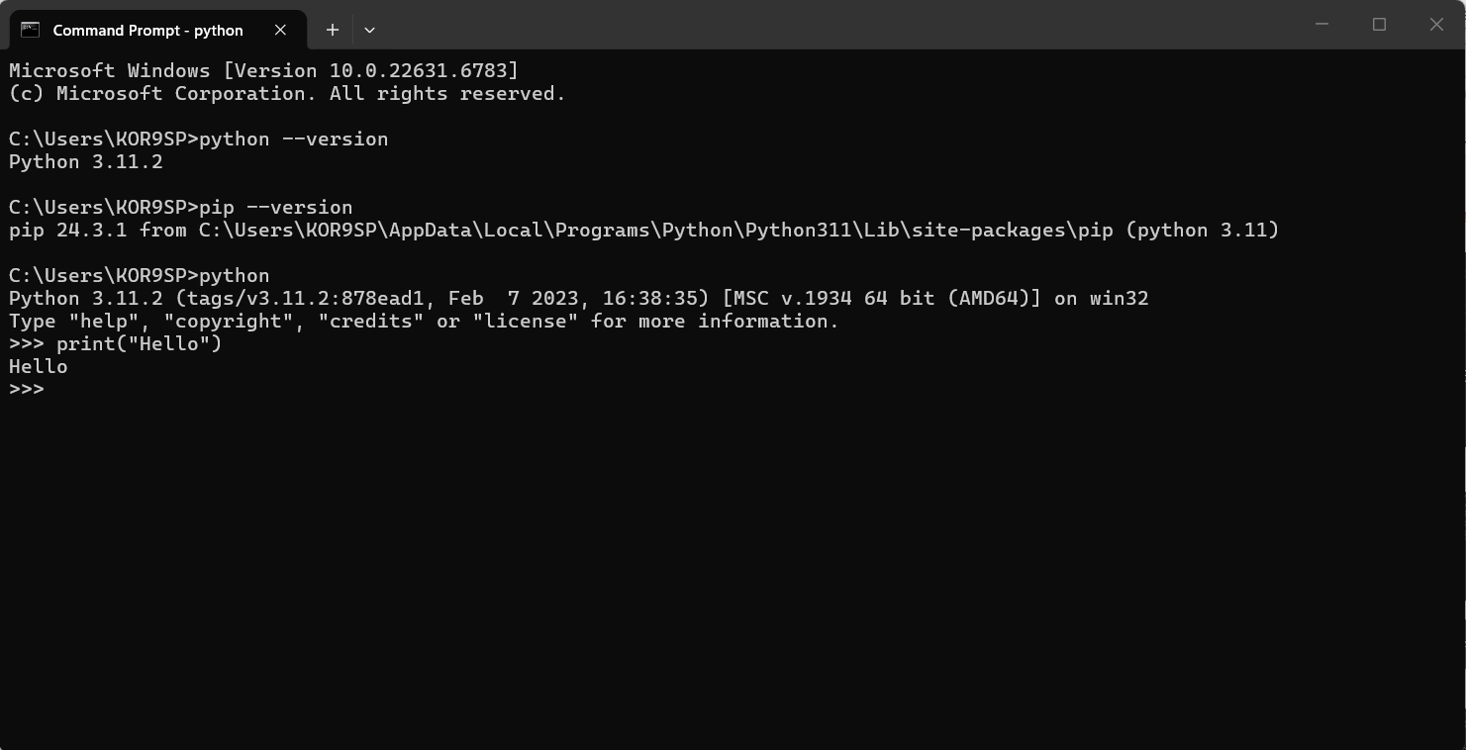
Check Install

Slide 10
Development Environments/Software
Jupyter Notebook
Code Editors (VS Code, or others)
Similar style to SAS, or R Studio
Everything will be generated in one window.
Run and execute individual lines
Be careful of virtual environments
Difficult to create and manage large code base/modules
Highly customizable
Extra extensions may need installed
Learn the editor
More difficult to run single lines of code
Easier to maintain and edit large code bases or multiple files.

Slide 11
Using Jupyter Notebook
Install using command line
pip install notebook
Other instructions: https://jupyter.org/
Run Jupyter Notebook
Open a folder
In the directory/navigation bar type cmd
Type python –m notebook
Run Kernel
On the right hand side select New >> Python <version> ipykernel
This will open a new tab and you can begin to write code
Be careful of installing and running in a Virtual Environment

Slide 12
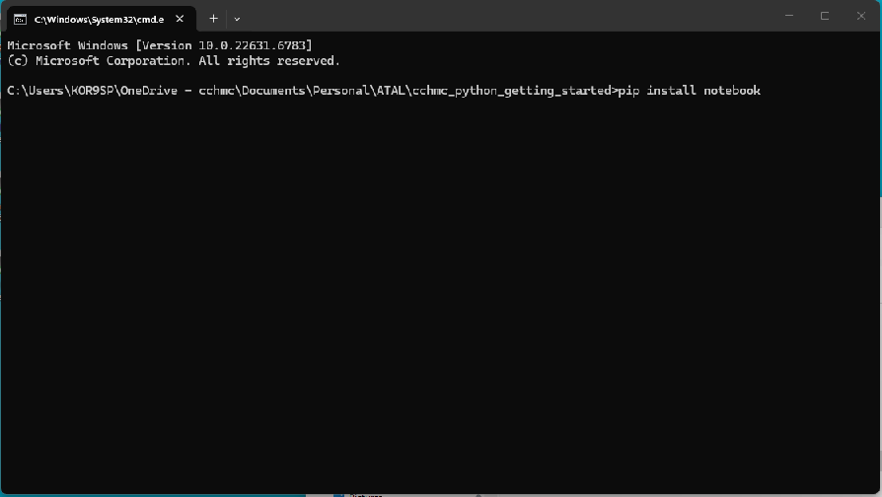
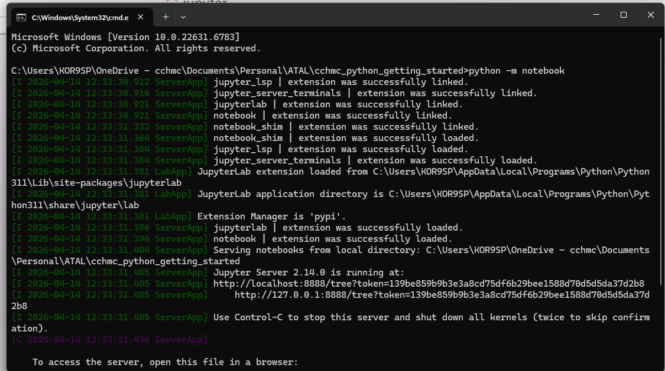

Slide 13
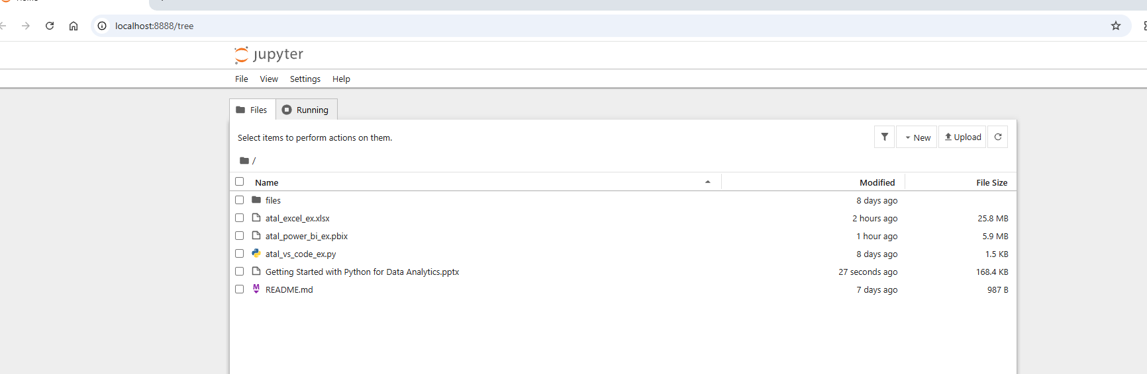
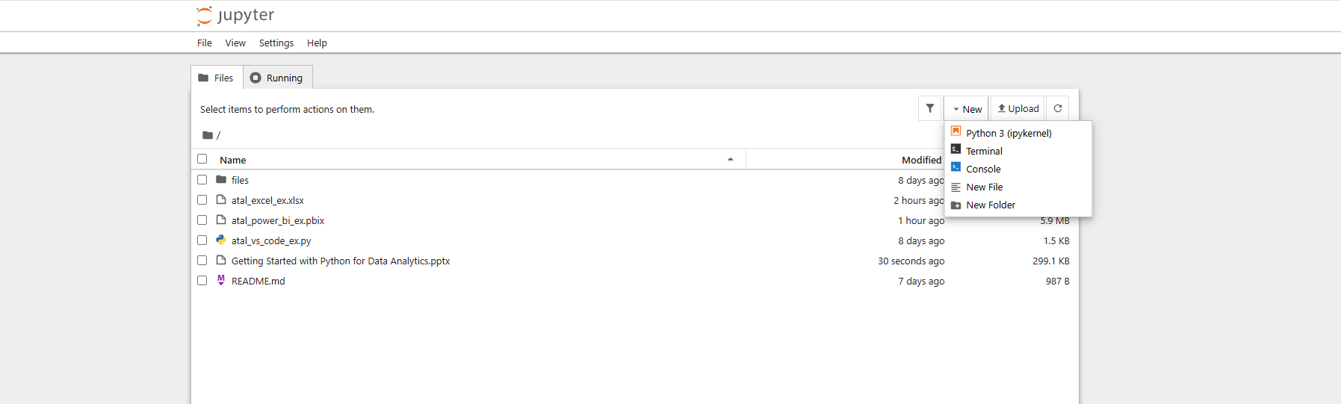

Slide 14
Using VS Code
Typical software install:
https://code.visualstudio.com/
May need temporary admin rights
Open VS Code
Select File and Open folder, navigate to your working directory
Install extensions:
Left hand side select Extensions
Search Python
Install Python Extension Pack
Create a <name>.py file
Enter Code and run by:
Clicking Run Python File in upper right corner
Select Run >> Start Debugging >> Python Debugger >> Python File
You can also create a launch json to skip past debug instructions each run
In the bottom terminal window type:
python <name>.py

Slide 15
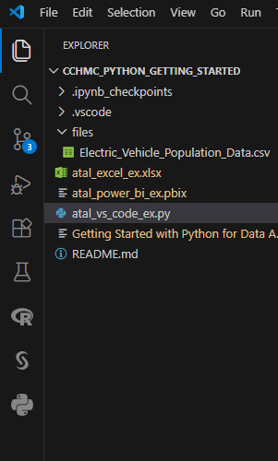
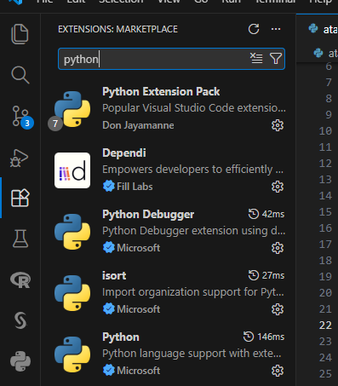
Select Widgets
Install Extensions

Slide 16
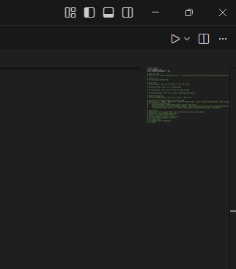
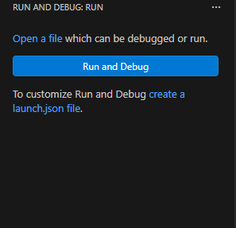
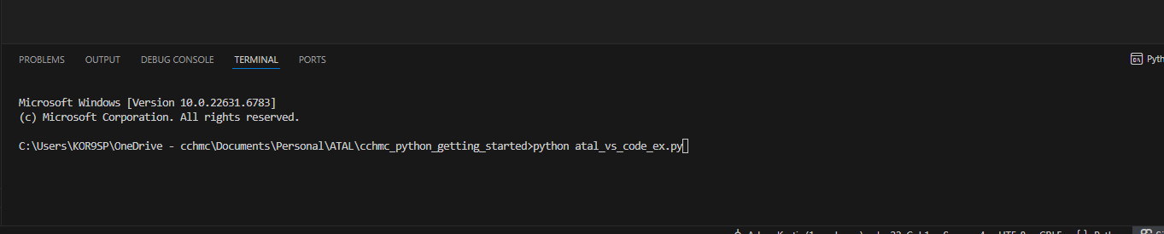
Create Launch JSON to Save Options
Run Script Using Debug Menu
Run Script Using “Run” Button
Run Script Using Terminal

Slide 17
Installing Modules
Most modules use pip to install:
pip install pandas
pip install pandas matplotlib scikit-learn
Popular modules:
Pandas – Data Analysis/Tabular data
Numpy – Scientific computing, arrays, matrices (included with pandas install)
Matplotlib, Seaborn – Charts and graphs
Scikit Learn, Tensor Flow – Machine Learning/Modelling
Beautiful Soup – Web Scraping
Openpyxl, Xlsxwriter – creating and modifying Excel spreadsheets
Multiple database connection modules

Slide 18
Implementing Python into Your Workflow
Not too different then what you may do with SAS or R
Load Data
Manipulate Data
Create Analysis
Export Results
Best way to get started:
Write code, write more code, and then write some more code
Start simple – do some simple learnings and simple programs
Re-write a program or parts of a program in Python
Write small new programs into your workflow
Focus on one element to learn and improve

Slide 19
Example
Live Demo Running Code VS Code, Jupyter, Excel, Power BI
Excel use py
Power BI use
Questions?
Marimo

